Slide 1
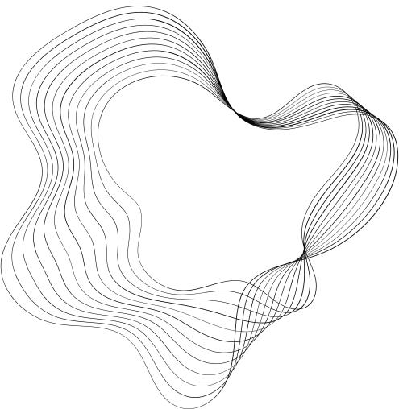
Sonic Skies:
Sonic Skies:
Final Report
Nathan Thoms, Taylor Johnson,
Jack Cassidy, John Lavigne

Slide 2
Goals & Objectives
Goals & Objectives
Use a pair of ZedBoards to pass information using sound signals to fly the MP-1 quadcopter using the training controller.
1st ZedBoard will be connected to the trainer controller, capture PPM information, and convert it into sound using the built in Audio CODEC ADAU1761 device connected to a speaker.
2nd ZedBoard will capture the sound using built-in audio device connected to a microphone and decode sound information, translated and sent to a PPM generator, and transmitted to the quadcopter.

Slide 3
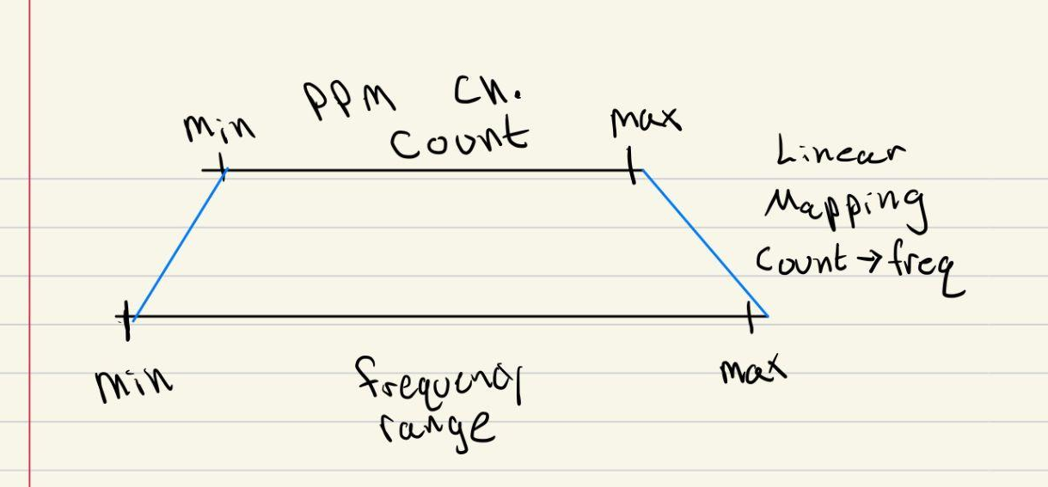
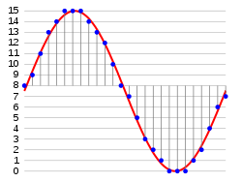
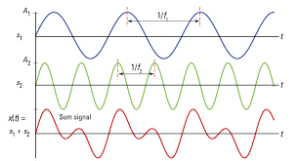
Audio Transmission
Read in PPM Channel Counts
Map counts to a given frequency range based on the channel
Produce sine waves at the target frequencies
Adjust magnitudes to combat noise frequency ranges
Sum the samples
Pass samples to audio codec (DAC)

Slide 4

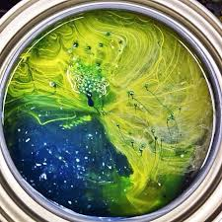

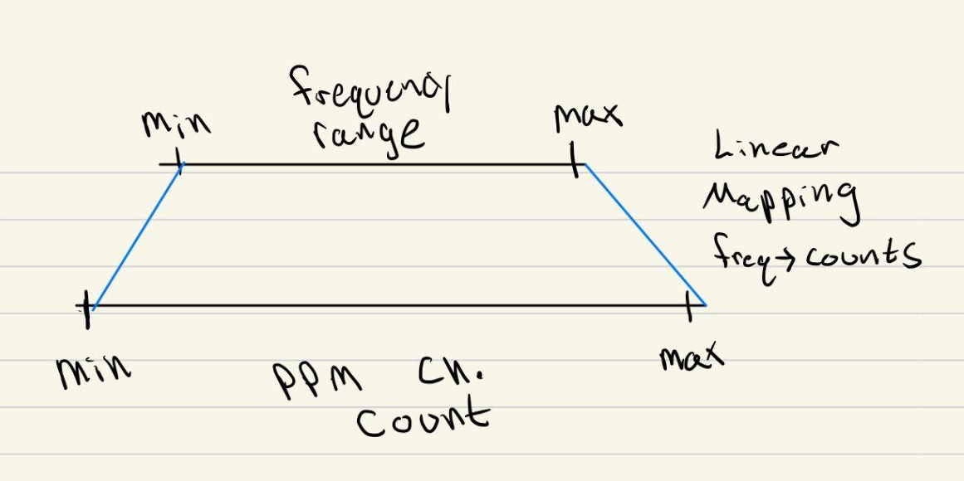
Audio Reception
Audio codec samples mic signal (ADC)
Samples read into buffer
Buffer = Configured transform length (FFT)
Perform transform
Detect the most prominent frequency within channel ranges
Map peak frequencies back into PPM counts
FFT

Slide 5
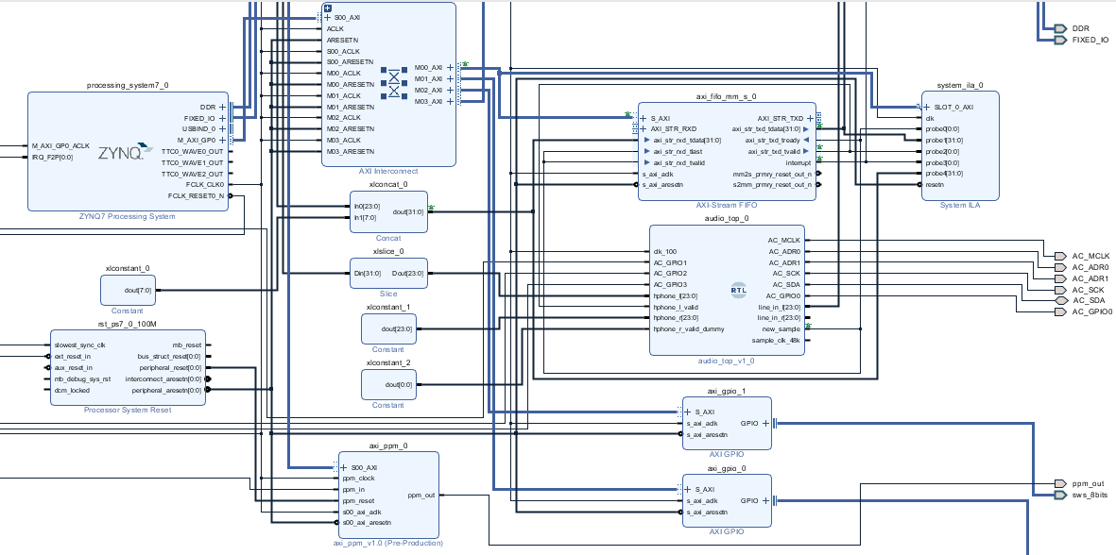
Hardware Design
Hardware Design
Setting-up audio codec
bare metal implementation over using linux due to driver issues
Use of IP block for handling I2S Transmission & Reception (Audio)
Use of IP block for I2C handling codec configuration (Register Writes)

Slide 6
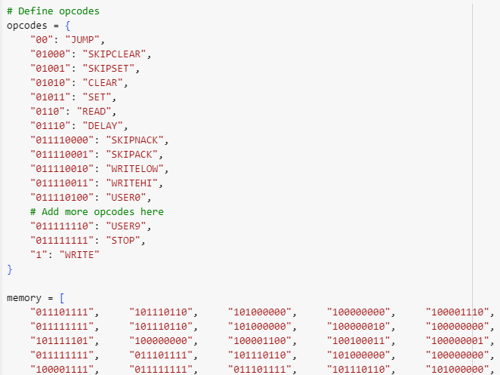
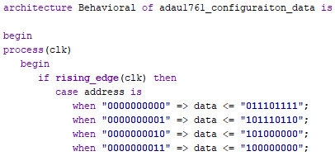
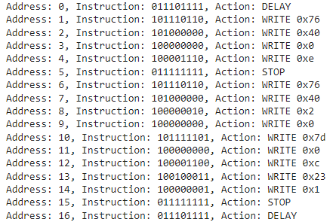
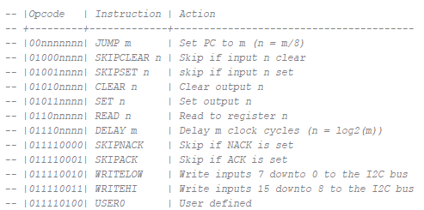
Challenges
Challenges
Python script to emulate I2C program
Configuring CODEC for mic input
Setup for line input by default
Instruction Address
Opcode
Emulator output
Black Box

Slide 7
What went right ?
What went right ?
FFT/DFT: Finding a C library to decode audio information
minfft library for its simplicity and performance
struct contains audio info
returns complex amplitudes and frequencies
issue of multiple peaks near max peak frequency (took max)
sampling rate 48kHz
Update MP-1 VHDL for ppm generation
axi_ppm_v1
track period count
stored that value into an unused slave register

Slide 8
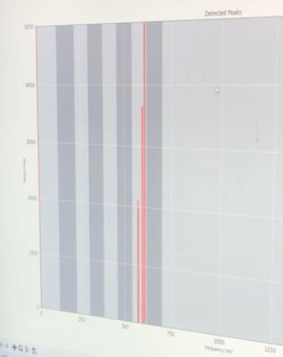
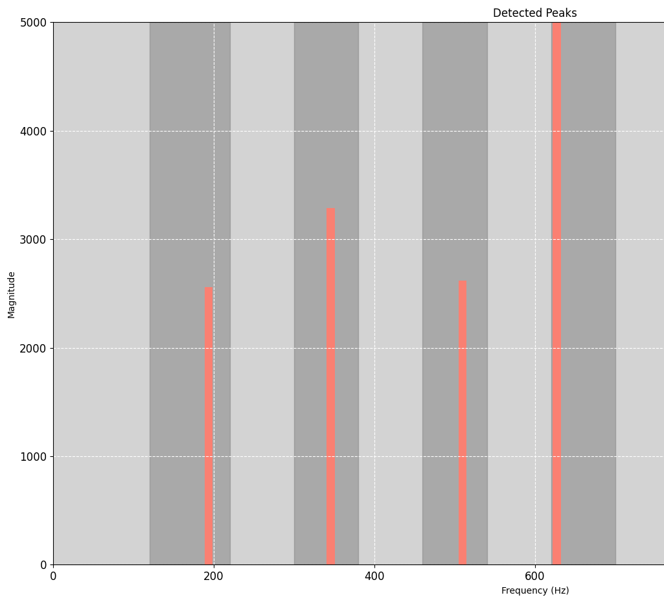

Magnitude vs Frequency Plots
Magnitude vs Frequency Plots
Detection of most prominent frequencies
Peak frequency for each channel

Slide 9
Points of Interest
Points of Interest
Characteristics about audio and audio processing
Audio processing from a zedboard
How to use FFT to collect audio characteristics
How to map PPM channels to different audio frequency and map them to a micro uav

Slide 10
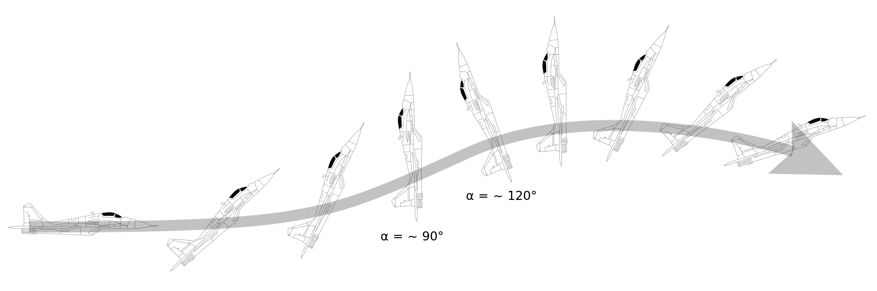
Grading Rubric
Grading Rubric

Slide 11
 | Proficiency/Performance Scale
 | 1: Crash & Burn (25 points) | 2: Landed in the Hudson (35 points) | 3: Landed Safely on Runway (45 points) | 4: Performed Barrel Roll in Flight (55 points) | 5: Performed Pugachev’s Cobra in Flight (65 points)
Production of Audio Signal | A valid attempt was made in getting audio production working | Can produce some form of sound from the ZedBoard Audio CODEC ADAU1761 device. | Can successfully produce audio signals and vary it using inputs from the Zedboard. | Can successfully produce an audio signal encoding a single ppm channel input from the RC trainer controller. | Can successfully produce an audio signal encoding required ppm channels input from the RC trainer controller.
Reception of Audio Signal | A valid attempt was made in getting audio reception working. | Can read in software - incoming audio through audio-in on Zedboard. | Can detect an incoming audio signal and extract variation details (e.g. amplitude, frequency). | Can extract multi-channel encoded audio signal details. | Can extract multi-channel encoded audio signals use HW accelerator IP
RC Controller & Quad-Copter Integration | A valid attempt was made in integrating, but the drone will not respond to any input. | Incoming audio can excite the Quad-Copter motors. | Can control a single RC channel using sound signals. | Can control all pertinent RC channels for flight from the RC trainer controller. | Demonstration of stable flight
Demonstration of effort in debugging | Little to no knowledge supporting effort. | Evidence showing attempts were made toward producing a working system (i.e research articles, TA interaction)
Demo & Report | Limited demo and report. | Full demo report includes descriptions of all major components. |  | Entertaining demo, report includes detailed figures and system evaluation results.

Slide 12
Questions?

